Slide 1
OBJECT ORIENTED
PROGRAMMING
Spring 2024
Miss Ayesha Majid

Slide 2
LECTURE – 7 - 8

Slide 3
Java Constructors
A constructor in Java is a special method that is used to initialize objects. The constructor is called when an object of a class is created. It can be used to set initial values for object attributes:

Slide 4
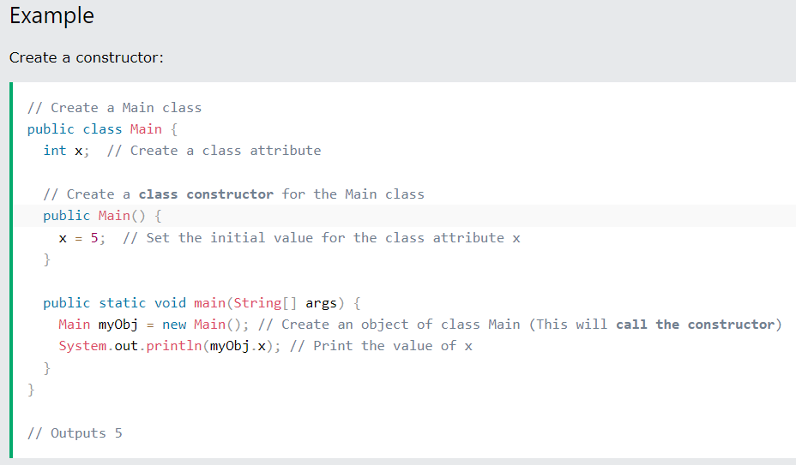
Java Constructors

Slide 5
Constructor
A constructor in Java Programming is a block of code that initializes (constructs) the state and value during object creation. It is called every time an object with the help of a new () keyword is created. Even if you haven't specified any constructor in the code, the Java compiler calls a default constructor.

Slide 6
Rules for creating a constructor
There are a few rules you must follow when creating constructors. These rules include:
The name of the constructor must be the same as the class name.
The constructor must have no return type.

Slide 7
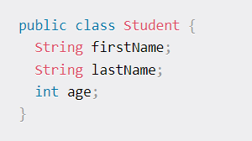
Before we proceed, let's see what a class looks like in Java:

Slide 8
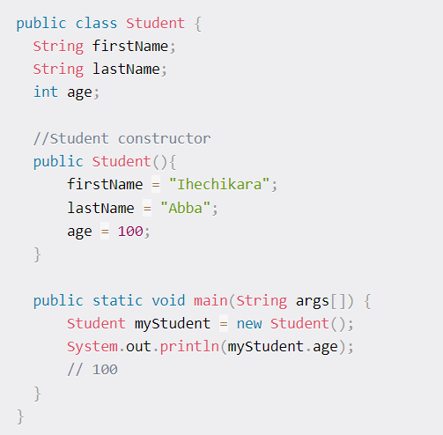
The code above shows a class called Student with three attributes – firstName, lastName, and age. We will assume that the class is supposed to be a sample for registering students. Recall that the three attributes do not have any values so none of the information is hard coded.
Now we will use constructors to create a new instance of our Student object. That is:

Slide 9
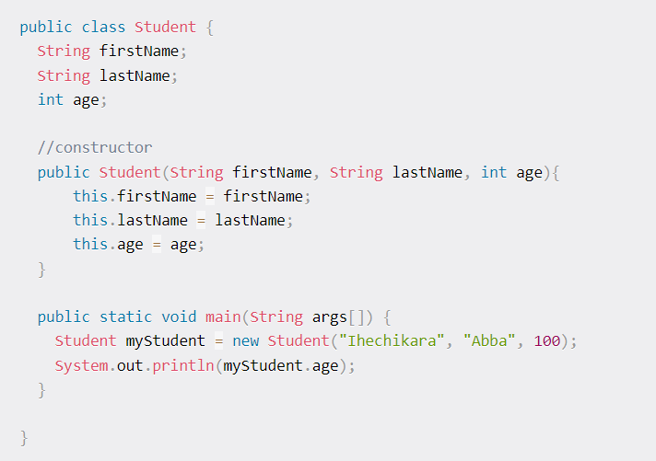
We have created a constructor which we used to initialize the attributes defined in the Student object. The code above is an example of a no-argument constructor. Let's see an example of a different kind now:

Slide 10
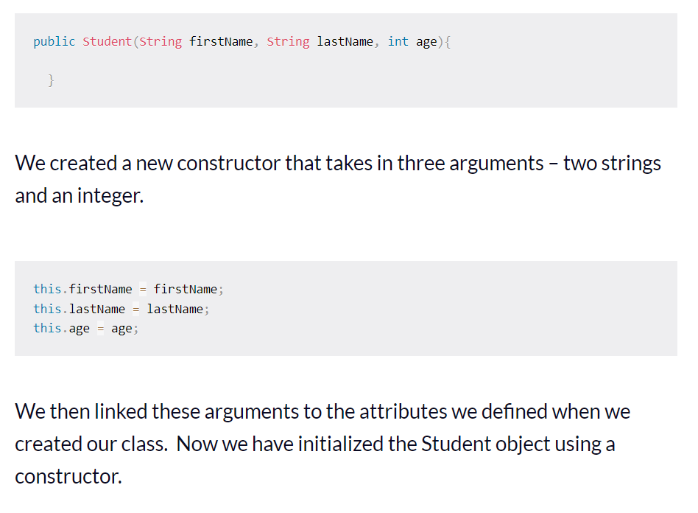
Now we have created a parameterized constructor. A parameterized constructor is a constructor created with arguments/parameters. Let's break it down.

Slide 11
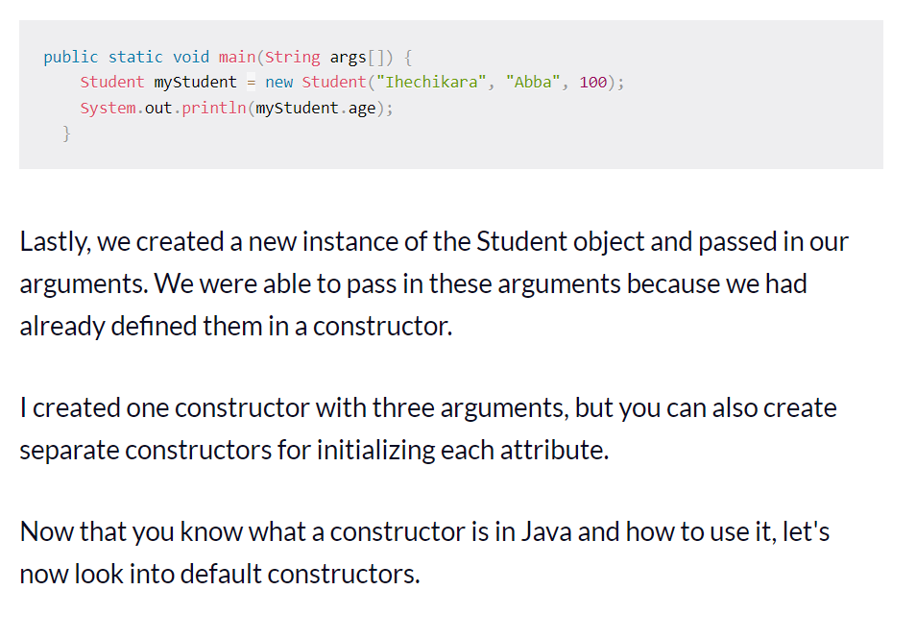

Slide 12
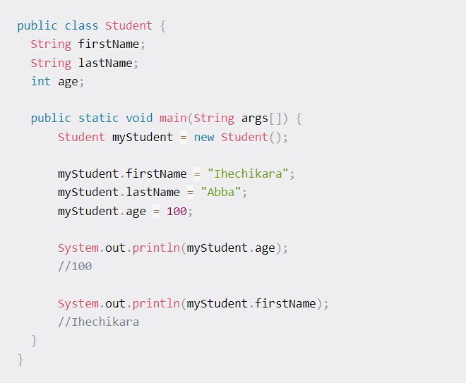
What is a default constructor?
A default constructor is a constructor created by the compiler if we do not define any constructor(s) for a class. Here is an example:

Slide 13
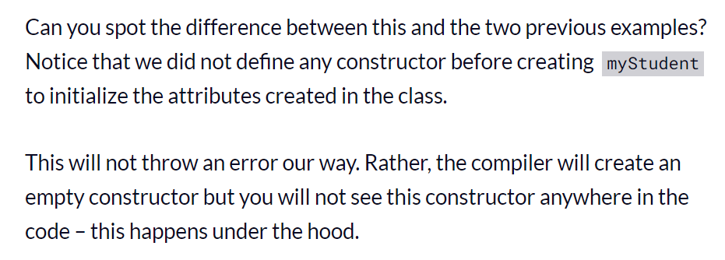

Slide 14
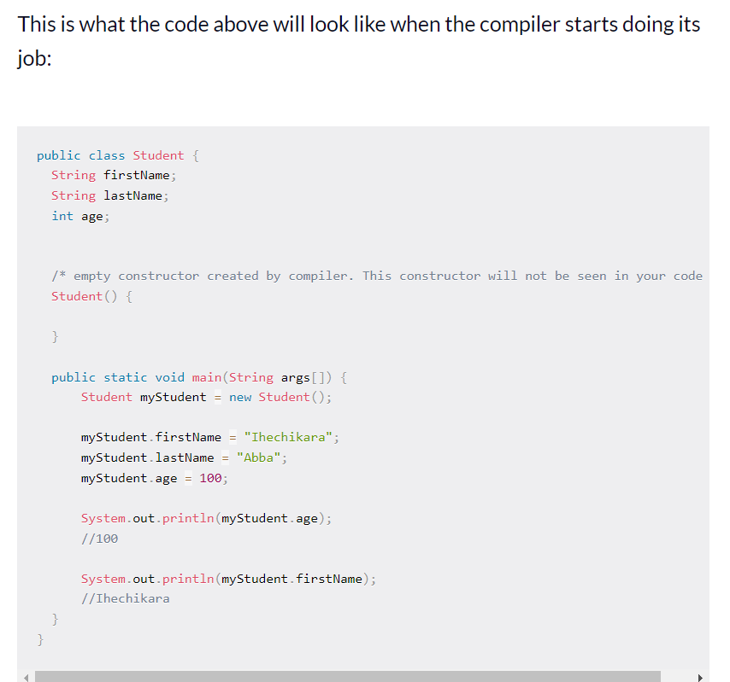

Slide 15
Principles of OOP

Slide 16
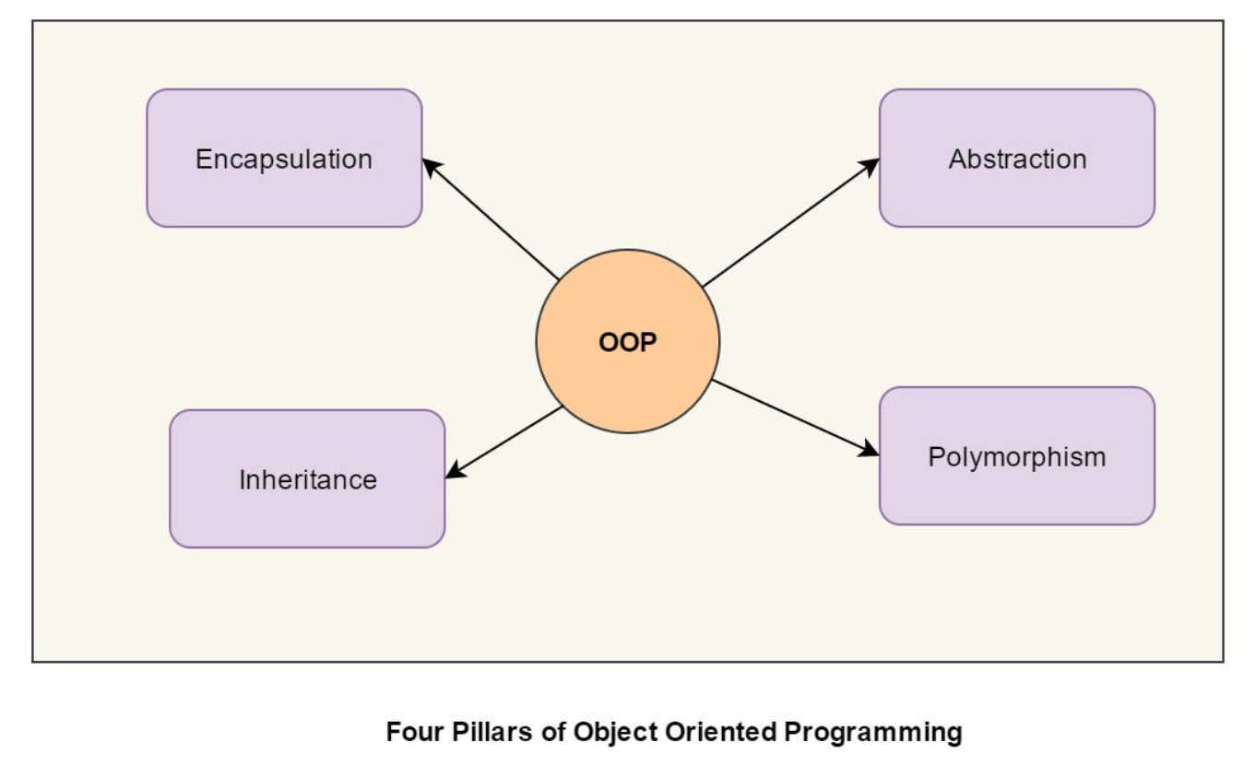

Slide 17
Abstraction :
Let's suppose you want to turn on the bulb in your room. What do you do to switch on the bulb. You simply press the button and the light bulb turns on. Right? Notice that here you're only concerned with your final result, i.e., turning on the light bulb. You do not care about the circuit of the bulb or how current flows through the bulb. The point here is that you press the switch, the bulb turns on! You don't know how the bulb turned on/how the circuit is made because all these details are hidden from you. This phenomenon is known as abstraction.
More formally, data abstraction is the way through which only the essential info is shown to the user, and all the internal details remain hidden from the user.

Slide 18
Polymorphism
Polymorphism is the ability of any data to be processed in more than one form. The word itself indicates the meaning as poly means many and morphism means types. Polymorphism is one of the most important concepts of object-oriented programming languages. The most common use of polymorphism in object-oriented programming occurs when a parent class reference is used to refer to a child class object. Here we will see how to represent any function in many types and many forms. In a real-life example of polymorphism, a person at the same time can have different roles to play in life. Like a woman, at the same time is a mother, a wife, an employee and a daughter. So the same person has to have many features but has to implement each as per the situation and the condition. Polymorphism is considered as one of the important features of Object Oriented Programming.

Slide 19
Inheritance:
Inheritance is a key concept in object-oriented programming that allows you to define a new class based on an existing class. The new class, called a subclass or derived class, inherits all of the properties and methods of the existing class, called the superclass or base class, and can also define its own unique properties and methods.

Slide 20
Encapsulation:
Encapsulation in Java is the process by which data (variables) and the code that acts upon them (methods) are integrated as a single unit. By encapsulating a class's variables, other classes cannot access them, and only the methods of the class can access them

Slide 21
Java Inheritance
Inheritance is one of the key features of OOP that allows us to create a new class from an existing class.
The new class that is created is known as subclass (child or derived class) and the existing class from where the child class is derived is known as superclass (parent or base class).

Slide 22
Why use inheritance?
The most important use of inheritance in Java is code reusability. The code that is present in the parent class can be directly used by the child class.
Method overriding is also known as runtime polymorphism. Hence, we can achieve Polymorphism in Java with the help of inheritance.

Slide 23

The syntax of Java Inheritance

Slide 24
Sample Example:
class Employee{
float salary=40000;
}
class Programmer extends Employee{
int bonus=10000;
public static void main(String args[]){
Programmer p=new Programmer();
System.out.println("Programmer salary is:"+p.salary);
System.out.println("Bonus of Programmer is:"+p.bonus);
}
}

Slide 25
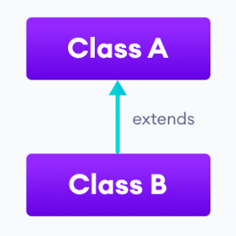
Types of inheritance
There are five types of inheritance.
1. Single Inheritance
In single inheritance, a single subclass extends from a single superclass. For example,

Slide 26
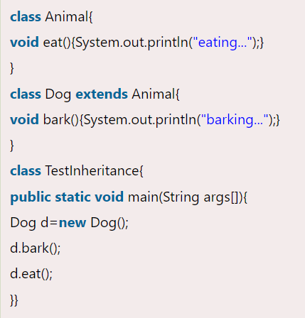
Single Inheritance Example

Slide 27
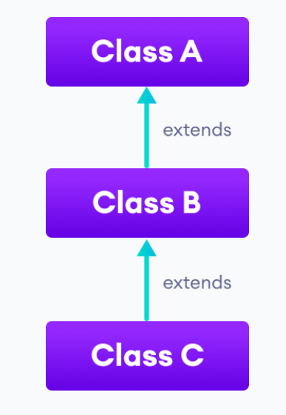
Types of inheritance
2. Multilevel Inheritance
In multilevel inheritance, a subclass extends from a superclass and then the same subclass acts as a superclass for another class. For example,

Slide 28
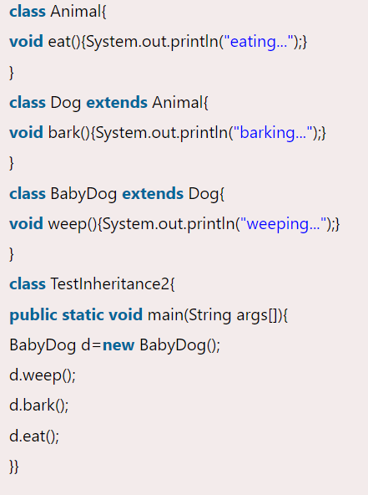
Multilevel Inheritance Example:

Slide 29
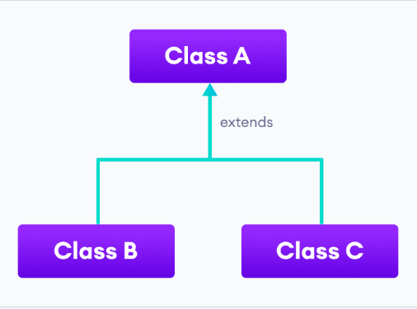
Types of inheritance
3. Hierarchical Inheritance
In hierarchical inheritance, multiple subclasses extend from a single superclass. For example,

Slide 30
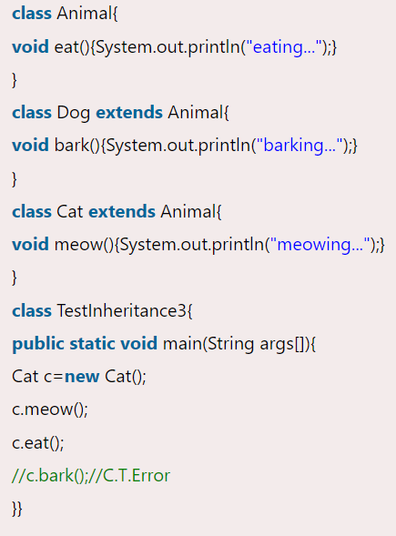
Hierarchical Inheritance Example:

Slide 31
Method Overriding in Java Inheritance
If subclass (child class) has the same method as declared in the parent class, it is known as method overriding in Java.
In other words, If a subclass provides the specific implementation of the method that has been declared by one of its parent class, it is known as method overriding.

Slide 32
Usage of Java Method Overriding
Method overriding is used to provide the specific implementation of a method which is already provided by its superclass.
Method overriding is used for runtime polymorphism

Slide 33
Rules for Java Method Overriding
The method must have the same name as in the parent class
The method must have the same parameter as in the parent class.
There must be an IS-A relationship (inheritance).
You cannot override a private, static and final method.

Slide 34
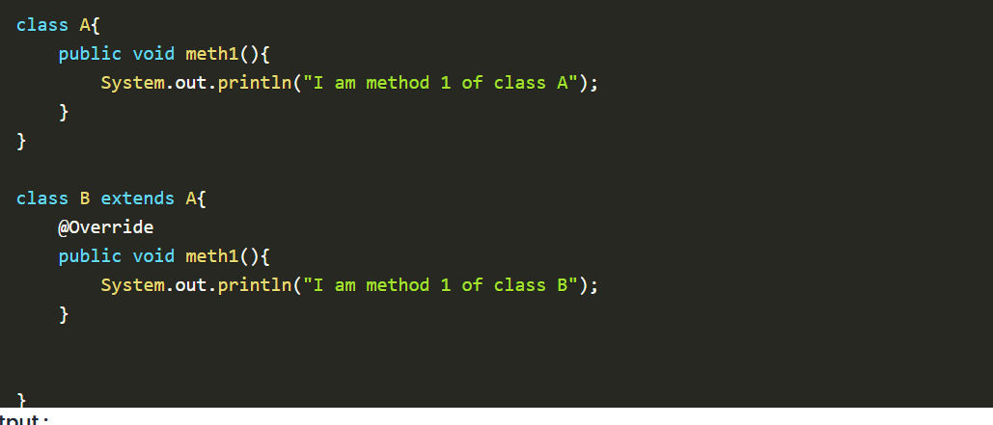
Sample Example of Method Overriding:

Slide 35
Constructor in Inheritance
Constructors in Java are used to initialize the values of the attributes of the object serving the goal to bring Java closer to the real world. We already have a default constructor that is called automatically if no constructor is found in the code. But if we make any constructor say parameterized constructor in order to initialize some attributes then it must write down the default constructor because it now will be no more automatically called.

Slide 36
Sample Example of Constructor in Java
// Java Program to Illustrate
// Invocation of Constructor
// Calling Without Usage of
// super Keyword
// Class 1
// Super class
class Base {
// Constructor of super class
Base()
{
// Print statement
System.out.println(
"Base Class Constructor Called ");
}
}
// Class 2
// Sub class
class Derived extends Base {
// Constructor of sub class
Derived()
{
// Print statement
System.out.println(
"Derived Class Constructor Called ");
}
}
// Class 3
// Main class
class GFG {
// Main driver method
public static void main(String[] args)
{
// Creating an object of sub class
// inside main() method
Derived d = new Derived();
// Note: Here first super class constructor will be
// called there after derived(sub class) constructor
// will be called
}
}

Slide 37
Output Explanation
Here first superclass constructor will be called thereafter derived(sub-class) constructor will be called because the constructor call is from top to bottom. And yes if there was any class that our Parent class is extending then the body of that class will be executed thereafter landing up to derived classes.
But, if we want to call a parameterized constructor of the base class, then we can call it using super(). The point to note is base class constructor call must be the first line in the derived class constructor.

Slide 38
Polymorphism in Java
Polymorphism is one of the main aspects of Object-Oriented Programming(OOP). The word polymorphism can be broken down into Poly and morphs, as “Poly” means many and “Morphs” means forms. In simple words, we can say that ability of a message to be represented in many forms.

Slide 39
Introduction
Let us understand the definition of polymorphism by an example; a lady can have different characteristics simultaneously. She can be a mother, a daughter, or a wife, so the same lady possesses different behavior in different situations.
Another example of polymorphism can be seen in carbon, as carbon can exist in many forms, i.e., diamond, graphite, coal, etc. We can say that both woman and carbon show different characteristics at the same time according to the situation. This is called polymorphism.
The definition of polymorphism can be explained as performing a single task in different ways. A single interface having multiple implementations is also called polymorphism.

Slide 40
How can polymorphism be achieved in Java?
Polymorphism in Java can be achieved in two ways i.e., method overloading and method overriding.
Polymorphism in Java is mainly divided into two types.
Compile-time polymorphism
Runtime polymorphism
Compile-time polymorphism can be achieved by method overloading, and Runtime polymorphism can be achieved by method overriding. In the further article, we will be discussing all the topics related to polymorphism in Java in more detail.

Slide 41
Polymorphism in Java Example
// Parent class to illustrate run-time polymorphism
class Parent {
// creating print method
void print() {
System.out.println("Hi I am parent");
}
}
// Child class extends Parent class
class Child extends Parent {
// overriding print method
void print() {
System.out.println("Hi I am children");
}
}
// Overload class to illustrate compile-time polymorphism
class Overload {
// Creating a statement method
void statement(String name) {
System.out.println("Hi myself " + name);
}
// overloading statement method
void statement(String fname, String lname) {
System.out.println("Hi myself " + fname + " " + lname);
}
}
public class Main {
public static void main(String[] args) {
// creating instance of parent
Parent obj1;
obj1 = new Parent();
obj1.print();
obj1 = new Child();
obj1.print();
// creating instance of overload
Overload obj2 = new Overload();
obj2.statement("Soham.");
obj2.statement("Soham", "Medewar.");
}
}

Slide 42
Example of polymorphism in real-life
// parent class Livingthings
class Livingthings {
// creating live method
public void live() {
System.out.print("live on ");
}
}
// Animals class extends Livingthings
class Animals extends Livingthings {
// overriding live method
public void live() {
System.out.println("water, air, and land.");
}
}
// Humanbeing class extends Livingthings
class Humanbeing extends Livingthings {
// overriding live method
public void live() {
System.out.println("land.");
}
}
// Plants class extends Livingthings
class Plants extends Livingthings {
// overriding live method
public void live() {
System.out.println("water and land.");
}
}
class Polymorphism {
public static void main(String[] args) {
// creating new object of Livingthings class
Livingthings LT = new Livingthings();
Livingthings LT1;
LT1 = new Animals();
System.out.print("Animals ");
LT.live();
LT1.live();
LT1 = new Humanbeing();
System.out.print("Human beings ");
LT.live();
LT1.live();
LT1 = new Plants();
System.out.print("Plants ");
LT.live();
LT1.live();
}
}

Slide 43
Method overloading
Consider a class where multiple methods have the same name. It will be difficult for the compiler to distinguish between every method.
To overcome this problem, we pass a different number of arguments to the method or different types of arguments to the method. In this way, we achieve method overloading.
In other words, a class can have multiple methods of the same name, and each method can be differentiated either by bypassing different types of parameters or bypassing a different number of parameters.

Slide 44
Example:
class CompileTime {
// perimeter method with a single argument
static int perimeter(int a) {
return 4 * a;
}
// perimeter method with two arguments (overloading)
static int perimeter(int l, int b) {
return 2 * (l + b);
}
}
class Polymorphism {
public static void main(String[] args) {
// calling perimeter method by passing a single argument
System.out.println("Side of square : 4\nPerimeter of square will be : " + Compiletime.perimeter(4) + "\n");
// calling perimeter method by passing two arguments
System.out.println("Sides of rectangle are : 10, 13\nPerimeter of rectangle will be : " + Compiletime.perimeter(10, 13));
}
}

Slide 45
Method overriding
If a child class has a method as its parent class, it is called method overriding.
If the derived class has a specific implementation of the method that has been declared in its parent class is known as method overriding.
Rules for overriding a method in Java
There must be inheritance between classes.
The method between the classes must be the same(name of the class, number, and type of arguments must be the same).

Slide 46
Example:
//parent class Animal
class Animal{
// creating place method
void place(){
System.out.println("Animals live on earth.");
}
}
// Dog class extends Animal class
class Dog extends Animal{
// overriding place method
void place(){
System.out.println("Dog lives in kennel.");
}
}
// Horse class extends Animal class
class Horse extends Animal{
// overriding place method
void place(){
System.out.println("Horse lives in stable.");
}
}
// Rabbit class extends Animal class
class Rabbit extends Animal{
// overriding place method
void place(){
System.out.println("Rabbit lives in burrow.");
}
}
class Polymorphism{
public static void main(String[] args) {
// creating object of Animal class
Animal A = new Animal();
A.place();
A = new Dog();
A.place();
A = new Horse();
A.place();
A = new Rabbit();
A.place();
}
}

Slide 47
Example 2:
// parent class Shape
class Shape{
// creating area method
void area(){
System.out.println("Formula for areas.");
}
}
// Square class extends Shape class
class Square extends Shape{
// overriding area method
void area(){
System.out.println("Area of square : a * a");
}
}
// Rectangle class extends Shape class
class Rectangle extends Shape{
// overriding area method
void area(){
System.out.println("Area of rectangle : 2 * (a + b)");
}
}
// Circle class extends Shape class
class Circle extends Shape{
// overriding area method
void area(){
System.out.println("Area of circle : pi * r * r");
}
}
class Polymorphism{
public static void main(String[] args) {
// creating new object of Shape class
Shape S = new Shape();
S.area();
S = new Square();
S.area();
S = new Rectangle();
S.area();
S = new Circle();
S.area();
}
}

Slide 48
Resources:
https://www.w3schools.com
https://www.javatpoint.com/object-and-class-in-java

